Slide 1


Implementation of Traffic
signal
Simulation
Guide name:
Presented by:
Dr.S.Christy Melwyn
Leela B
P PadmaPriya
Yoshika

Slide 2
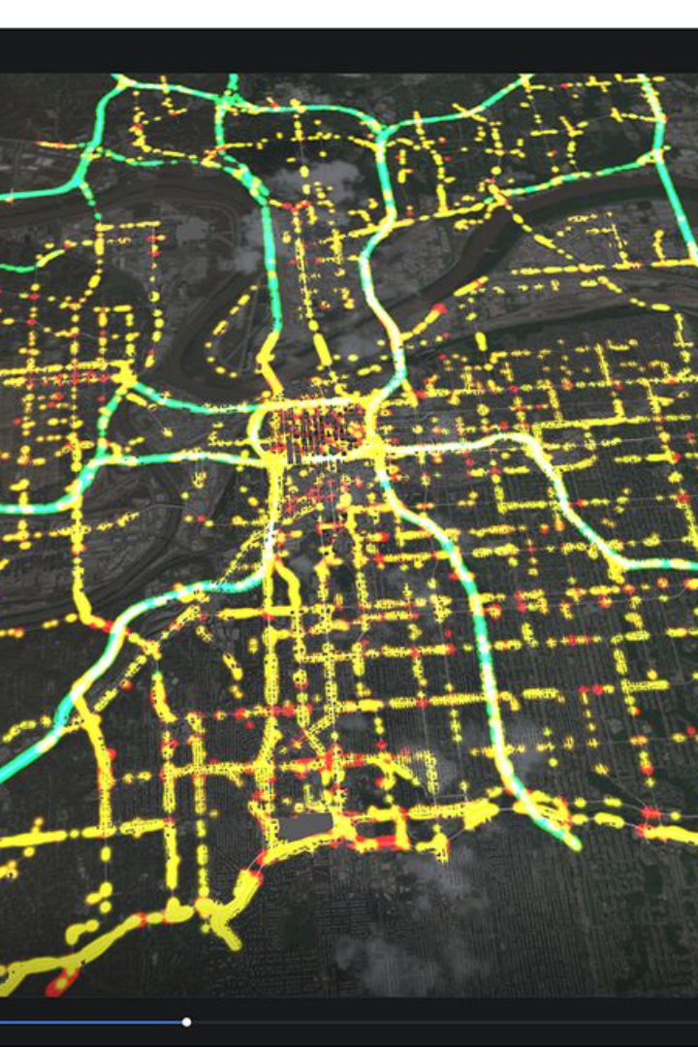
Introduction
we are aiming to develop a traffic signal simulator using Python. This project will involve simulating realistic traffic scenarios and developing an intuitive user interface to control the signals.

Slide 3
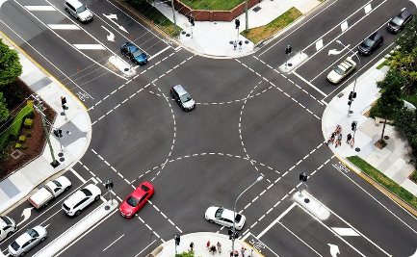
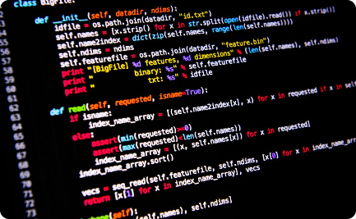
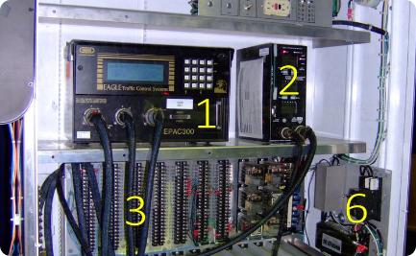

Abstract
Scenario Visualization
Development Process
User Interface
We will create realistic visual representations of various traffic scenarios to simulate the functioning of traffic signals accurately.
We will outline the step-by-step process of coding the project in Python, emphasizing the logic and implementation of traffic signal control.
An intuitive and interactive user interface will be designed to allow easy control and monitoring of the traffic signal simulator.

Slide 4
Features:
Multiple Intersections: Expand the simulator to include multiple intersections with synchronized signals to simulate traffic flow along a road.
Vehicle and Pedestrian Simulation: Add realistic vehicle and pedestrian behaviors, such as acceleration, deceleration, lane changes, and pedestrian crossings.
Traffic Density and Flow Control: Implement algorithms to control traffic density and flow, such as adjusting the rate at which vehicles enter the simulation and changing signal timings based on traffic conditions.
Emergency Vehicle Priority: Include a feature to prioritize emergency vehicles, allowing them to pass through intersections quickly and safely.
User Interaction and Control: Provide a user interface to allow users to control various aspects of the simulation, such as signal timings, traffic density, and simulation speed.
Data Visualization and Analysis: Add graphs and charts to visualize simulation data, such as traffic flow, congestion levels, and signal timings, to analyze the effectiveness of different traffic management strategies.
Scenario Creation and Testing: Allow users to create and test different traffic scenarios, such as rush hour traffic, special events, and road closures, to evaluate the impact on traffic flow and congestion.
Real-time Traffic Updates: Integrate real-time traffic data to simulate dynamic traffic conditions, such as accidents, road closures, and construction zones, to make the simulation more realistic.

Slide 5
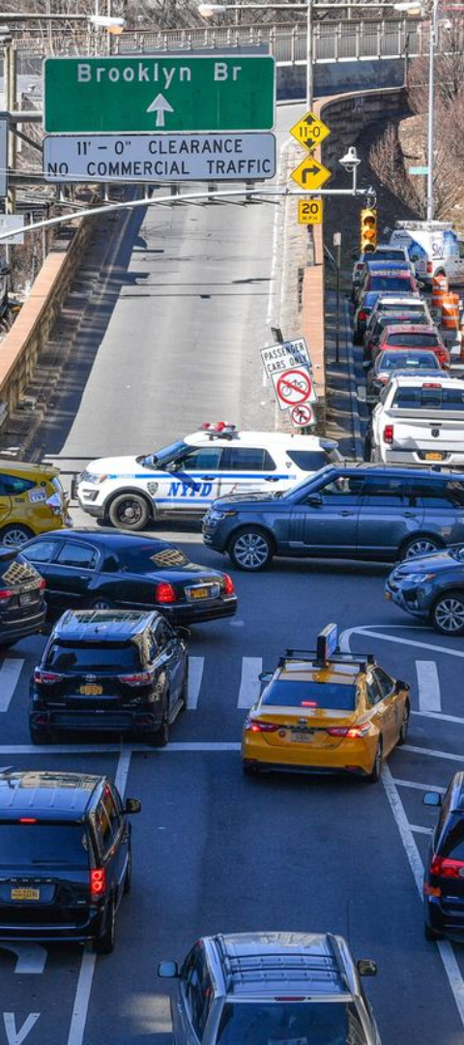
Problem Statement
Realistic Traffic Modeling
Optimized Signal Patterns
The challenge lies in creating accurate traffic models that reflect real-world scenarios and behavior.
We need to address the issue of optimizing signal patterns to ensure smooth traffic flow and minimize congestion.
Integration with Python
The project should seamlessly integrate with Python, leveraging the language's powerful capabilities for efficient traffic signal simulation.

Slide 6
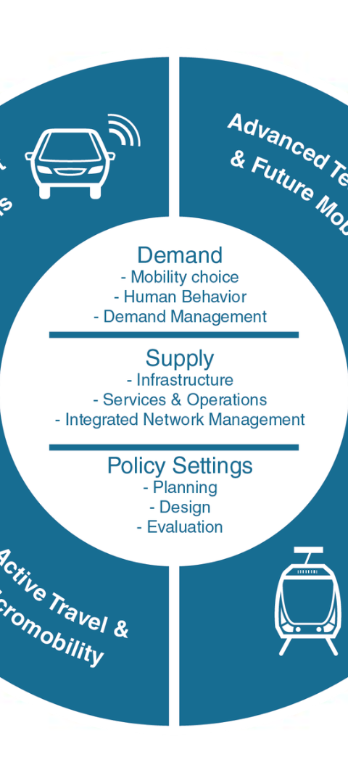
Proposed Objectives
1
Research on Traffic Behavior
Understanding and studying real traffic behavior patterns to replicate them in the simulation accurately.
2
Designing Signal Control Logic
Creating algorithms to determine optimal signal patterns for different traffic scenarios.
3
User Interface Development
Designing an interactive user interface for controlling and monitoring the simulated traffic signals.

Slide 7
MATERIALS AND METHODS
Programming Language: Python is a great choice for developing a traffic signal simulator due to its readability and ease of use.
GUI Library: Use a GUI library such as Tkinter, PyQt, or Pygame to create the graphical interface for your simulator.
Simulation Logic: Implement the logic for simulating the operation of traffic signals, including phases (e.g., green, yellow, red), timing, and transitions between phases.
Vehicle and Pedestrian Management: Manage the movement of vehicles and pedestrians, including queues, movement patterns, and interactions with traffic signals.
User Interaction: Allow users to interact with the simulator, such as starting and stopping the simulation, changing signal timings, and viewing simulation data.

Slide 8
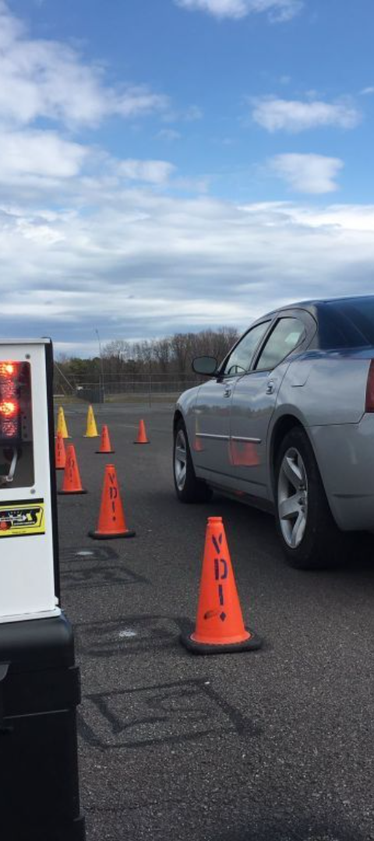
Novelty
1
Real-Time Simulation
2
Dynamic Signal Adjustments
The project aims to achieve real-time simulation of traffic behavior and signal control, providing an authentic experience.
The system will dynamically adjust signal timings based on traffic flow, responding to changing conditions instantly.
3
Data-Driven Signal Logic
Utilizing data-driven insights to optimize signal patterns and enhance the traffic simulation's realism and efficiency.

Slide 9
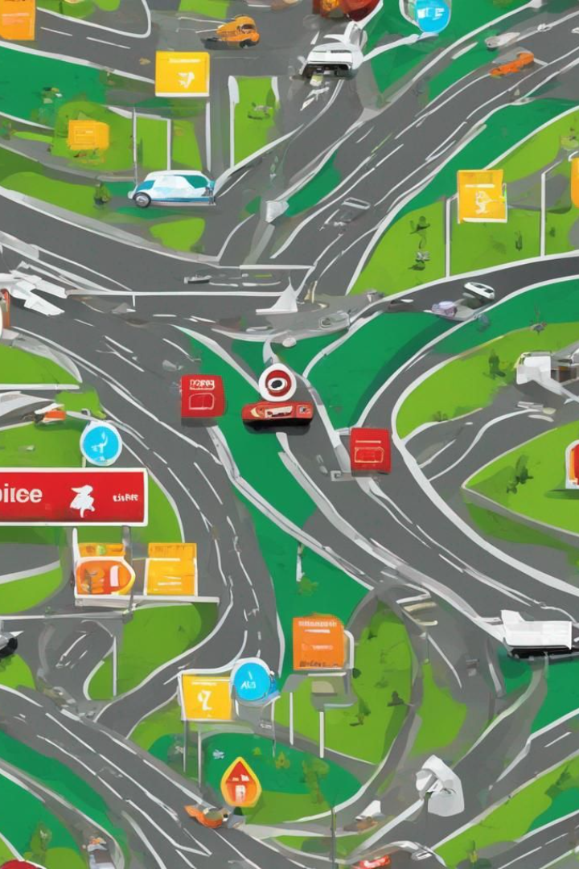
Design
In addition to the simulation functionality, our project focuses on creating visually appealing and user-friendly designs. We employ modern design principles to ensure a seamless user experience and an intuitive interface. Our goal is to provide an engaging and interactive traffic signal simulation that is both functional and aesthetically pleasing.

Slide 10
Scope:
Requirements Gathering: Define the specific requirements and objectives of the simulator, considering the desired features and functionalities.
Design and Architecture: Design the overall architecture of the simulator, including the simulation engine, user interface, and data management components.
Implementation: Implement the simulator based on the design, ensuring that each feature is implemented correctly and efficiently.
Testing and Validation: Test the simulator extensively to ensure that it behaves as expected under various scenarios and conditions.
Deployment and Integration: Deploy the simulator for use and integrate it with other systems or data sources, if necessary.
User Feedback and Iteration: Gather feedback from users and stakeholders to identify areas for improvement and iterate on the simulator to enhance its functionality and usability.
Maintenance and Support: Provide ongoing maintenance and support for the simulator, including bug fixes, updates, and user support.

Slide 11



Implementation
Python Development
User Interface Design
Testing and Validation
Emphasis will be put on creating an intuitive and visually appealing user interface for the traffic signal control system.
The project will leverage Python's rich libraries and flexibility to implement complex traffic simulation algorithms.
Rigorous testing and validation procedures will ensure the accuracy and reliability of the traffic signal simulator.

Slide 12
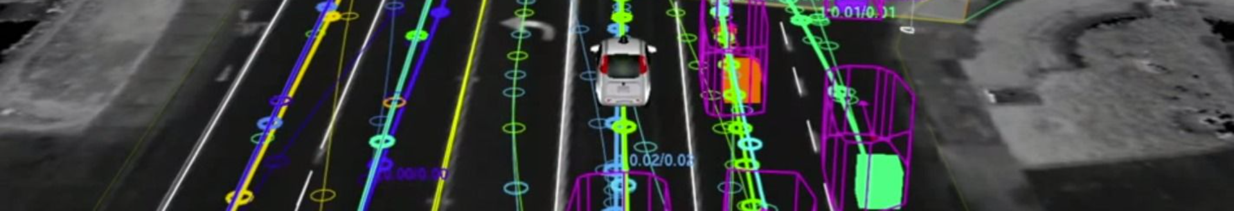



Conclusion
Exciting Endeavor
Real-World Application
Potential Impact
Developing a traffic signal simulator in Python presents an exciting and challenging opportunity for learning and innovation.
The implementation of this project could contribute to advancements in transportation technology and infrastructure.
The skills and insights gained from this project can be directly applied to real-world traffic management and control systems.

Slide 13

Thank You!

